Slide 1

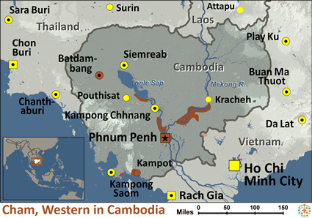
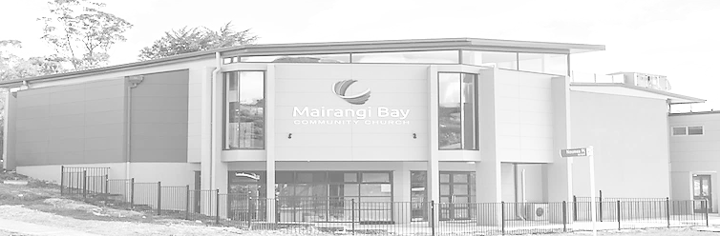
Pray for Nations “Declare His glory among the nations” Ps 96:3
Western Cham in Cambodia
Long ago, the Cham had a strong empire, called Champa, located in southern Vietnam. In 1471, Champa was invaded and destroyed by the Vietnamese and most freemen and aristocrats fled to Cambodia. In 1975, more than 250,000 Muslim Cham lived in Cambodia. With the rise of the Khmer Rouge regime, however, their population was decimated. Captured and removed from their homes, they were forbidden to speak their own language and forced to eat pork, which is an abomination to Muslims. About 100,000 Cham were said to have been executed. Cham villagers are
Presented by Joshua Project
Knowing Jesus More and Making Him Known
Weekly Bulletin
Sunday 31 March 2024
extremely poor and their settlements convey a sense of impermanence. They are now largely integrated into the Cambodian lifestyle and many now speak Khmer.
Ministry Obstacles: This Muslim community living in Buddhist Cambodia may have become especially protective of their religious tradition.
Outreach Ideas: There is a need for sustained prayer to prepare hearts of the Cham. Gospel recordings and the JESUS Film can both be useful in communicating the good news of Jesus.
Prayer Focus: There are some believers in Christ among the Cham of Cambodia. Pray the JESUS Film and gospel recordings (which are available) would be taken to these believers. Workers need to rise up in courage to share the gospel with the Western Cham people of Cambodia. Pray for improved living conditions for the Cham, for employment opportunities and for good schools to be available for the children.and would draw many Bosniaks to himself.
Population: | 256,000
World Population: | 327,900
Main Language: | Cham, Western
Main Religion: | Islam
Bible: | New Testament
Online Audio NT: | Yes
Jesus Film: | Yes
Audio Recordings: | Yes
Worship Service
10 am (with Live Stream)
Topic: The Cross as the Centre
Scripture: 1 Corinthians 2:1-5
Preacher: Duane Newport
VERSE FOR THE WEEK— 1 Corinthians 2:1-5
And so it was with me, brothers and sisters. When I came to you, I did not come with eloquence or human wisdom as I proclaimed to you the testimony about God.[a] 2 For I resolved to know nothing while I was with you except Jesus Christ and him crucified. 3 I came to you in weakness with great fear and trembling. 4 My message and my preaching were not with wise and persuasive words, but with a demonstration of the Spirit’s power, 5 so that your faith might not rest on human wisdom, but on God’s power.
Pre-Service Prayer at 9:30 am in lounge, all welcome.
49 Maxwelton Drive, Mairangi Bay, North Shore, Auckland 0630
Ph 09 478-6314, Website: www.mairangichurch.org.nz, Email: office@mairangichurch.org.nz

Slide 2

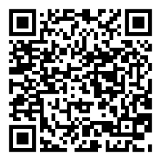
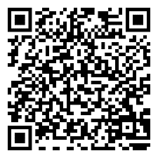
WELCOME TO MAIRANGI BAY COMMUNITY CHURCH (MBCC)
If this is your first time worshipping with us, please go to the Welcome Corner after the service. We will gladly answer your questions about our church. MBCC is an intentionally multi-cultural church and welcomes and celebrates all languages & cultures.
欢迎中国朋友参加. どの国の方も大歓迎します。
NEWS & EVENTS
PRAYER & INTERCESSION
“and pray for one another,” James 5:16b
Please visit the Prayer Wall in the foyer. Pin your prayers, answers to prayers or testimonies to the prayer wall. Remember to pray for the requests on our prayer wall.
GIVE THANKS & PRAY FOR
Pray for the church and brothers and sisters, may the Holy Spirit lead us to grow together in love and knowledge, and bear the fruit of the Holy Spirit.
Pray for Ming, Kevin, Joyce and Shuping for their therapies. May God heal them and give them strength.
Church Outreach
Street Evangelism
Sat 10.00 am – 12.00 pm
Flora: 021 201 9577
Music For Kiddies (Japanese)
School terms, every 2nd, 4th and 5th Thurs 10.30 am – 12.00 pm
Maki: 027 3803627 (Japanese)
Food Bank Contact Caroline/Dalice
Good News Flower Arrangement
Annie Zhang: 027 3939345
English Class：
Every Monday 10-2 pm church
downstairs
Grace (0226387288)
Encounter (Church Worship & Prayer Evening （every 1st and 3rd Sunday Evening)
7th April, 21st April
You may pray in your mother tongue with different language groups.
Other Monthly Worship Service in Different Languages (once a month)
Chinese Service:
Last Friday each month 7:30pm
If you would like to hear a Chinese translation, please ask for a headset. Please put the low battery headset in the yellow tray and the charged ones back to the original slot.
如果您需要听中文翻译可以向服事人员要一个耳机。请将需要充电的耳机放在黄色的盒子里，正常的耳机请放回原来的盒子。
CHURCH STAFF CONTACT INFORMATION
Church Office: 09 478 6314, office@mairangichurch.org.nz
General Office Hours: 9.30 am-12.30 pm, Tue - Fri (booking needed for appointments)
Acting Senior Pastor, David Yeh: 022 5220 670, david@mairangichurch.org.nz
Associate Pastor, Bijoy Joy: 020 4020 6404, bijoy@mairangichurch.org.nz
Chinese Evangelist, Wendy Liu: 021 0265 4800, wendy@mairangichurch.org.nz
Church Administrator, Cobi Wu: office@mairangichurch.org.nz
Shared Lunch
Today after the service,
Please join us!
Passover Meal
22 April(Mon), 6.30pm @church
$30 pp, RSVP, maximum 55 people.
Registration deadline is 14 April
Food Bank Contact
Caroline La Grange: 021 124 6996, carolinelagrange7@gmail.com
Dalice Yang: 022 065 1109, yangjie625@gmail.com
Healing Trauma Series
Starting from 27 March, 12 weeks,
Every Wednesday 10 -1pm,
@ church lounge
Want to give to God’s work through MBCC?
Contact the church office, or fill in this form and hand it in at the front desk
（please keep this as your own record as well!!)
Please I need an offering number (it is not necessary, but once you have had one, please use it as a reference consistently ) yes no
I need the donation receipt (for IRD tax rebate by the end of each financial year)
please show my name as (print):
and send through my email (print) :
General/Tithe donation 12-3050-0301948-00; Food Bank -03; Outreach -04
Ushers & Greeters & Tea Team
Training postponed to 14 April after the service @ lounge
Newcomers Detail
please scan the QR code to fill in
Contact pastor David Yeh/Wendy for the special/urgent prayer requests. Our Prayer Ministry Team will pray for you.
English
中文

