Slide 1
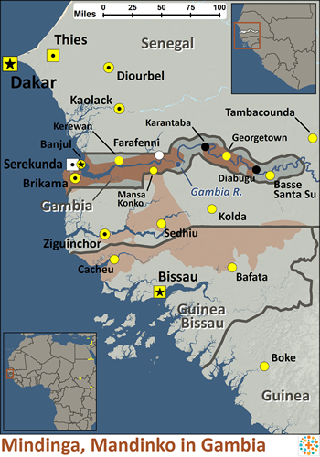
Pray for Nations “Declare His glory among the nations” Ps 96:3
Mandinka in Gambia
Mandinka society is divided into three divisions: free-born, artisans and slaves. Though once the free-born were only nobility, their ranks now include farmers, merchants and clergy. The majority of Mandinka are farmers. Mandinka villages are made up of clans, each sharing a family name. The religion practiced among the Mandinka is Islam, though it has been blended with their traditional beliefs, and few know what their rituals mean. It is not uncommon for someone to pray in the mosque then sacrifice a chicken to the village spirit.
Ministry Obstacles: Because the Mandinka practice Islam, there may be resistance to the gospel.
Outreach Ideas: Since the Mandinka tend to look upon artisans with respectful fear (especially blacksmiths and leather workers), it may prove beneficial to teach through the arts. They are especially fond of music, and their griots (praise singers) among the Mandinka have even impacted the national anthems of four West African nations. Culturally appropriate gospel music can be an excellent evangelistic tool.
Prayer Focus: Pray for a strong church community to be established among the Mandinka in the Gambia. Pray for spiritual wisdom and favor for missionaries focusing on the Mandinka. Pray for Mandinka believers to have boldness and love to share the gospel with their families and neighbors.
Presented by Joshua Project
Knowing Jesus More and Making Him Known
Weekly Bulletin
Sunday 2 June 2024
Population: | 1,165,000
World Population: | 2,435,500
Main Language: | Mandinka
Main Religion: | Islam
Bible: | New Testament
Online Audio NT: | Yes
Jesus Film: | Yes
Audio Recordings: | Yes
Worship Service
10 am (with Live Stream)
Topic: The Great Restorer
Scripture: 1 Peter 5: 8-11
Preacher: Pastor Bijoy
VERSE FOR THE WEEK— 1 Peter 5: 8-11
8 Be alert and of sober mind. Your enemy the devil prowls around like a roaring lion looking for someone to devour. 9 Resist him, standing firm in the faith, because you know that the family of believers throughout the world is undergoing the same kind of sufferings.
10 And the God of all grace, who called you to his eternal glory in Christ, after you have suffered a little while, will himself restore you and make you strong, firm and steadfast. 11 To him be the power for ever and ever. Amen.
Pre-Service Prayer at 9:30 am in lounge, all welcome.
49 Maxwelton Drive, Mairangi Bay, North Shore, Auckland 0630
Ph 09 478-6314, Website: www.mairangichurch.org.nz, Email: office@mairangichurch.org.nz

Slide 2
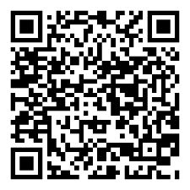
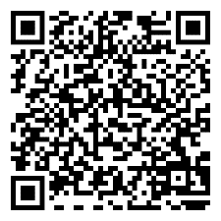
WELCOME TO MAIRANGI BAY COMMUNITY CHURCH (MBCC)
If this is your first time worshipping with us, please go to the Welcome Corner after the service. We will gladly answer your questions about our church. MBCC is an intentionally multi-cultural church and welcomes and celebrates all languages & cultures.
欢迎中国朋友参加. どの国の方も大歓迎します。
NEWS & EVENTS
PRAYER & INTERCESSION “and pray for one another,” James 5:16b Please visit the Prayer Wall in the foyer. Pin your prayers, answers to prayers and testimonies. Remember to pray for the requests.
GIVE THANKS & PRAY FOR
Pray for the church and brothers and sisters. May the Holy Spirit lead us to grow together in love and knowledge and bear the fruit of the Holy Spirit.
Pray for Ming, Joyce and Shuping for their treatments. May God heal them and give them strength.
Church Outreach
Street Evangelism Sat 10.00 am – 12.00 pm Flora: 021 201 9577
Music For Kiddies (Japanese) School terms, every 2nd, 4th and 5th Thurs 10.30 am – 12.00 pm Maki: 027 3803627 (Japanese)
Food Bank Contact Caroline/Dalice
Good News Flower Arrangement Annie Zhang: 027 3939345
English Class：
Every Monday, 10-2 pm
Church downstairs
Grace (0226387288)
Encounter (Church Worship & Prayer Evening （every 1st and 3rd Sunday Evening)
2nd June (Tonight) 16th June
You may pray in your own language with different language groups.
Other Monthly Worship Service in Different Languages (once a month)
Chinese Service:
Last Friday of each month, 7:30 pm
If you would like to hear a Chinese translation, please ask for a headset. Please put the low battery headset in the yellow tray and the charged ones back to the original slot.
如果您需要听中文翻译可以向服事人员要一个耳机。请将需要充电的耳机放在黄色的盒子里，正常的耳机请放回原来的盒子。
CHURCH STAFF CONTACT INFORMATION
Church Office: 09 478 6314, office@mairangichurch.org.nz
General Office Hours: 9.30 am-12.30 pm, Tue - Fri (booking needed for appointments)
Acting Senior Pastor, David Yeh: 022 5220 670, david@mairangichurch.org.nz
Associate Pastor, Bijoy Joy: 020 4020 6404, bijoy@mairangichurch.org.nz
Chinese Evangelist, Wendy Liu: 021 0265 4800, wendy@mairangichurch.org.nz
Church Administrator, Joanne Sham: office@mairangichurch.org.nz
Wheat Sale
$40 per container
See John Tan for more details.
Quiz Night
Time: 5pm-7:30pm 20th July,
@church downstairs.
Sign up in groups of 5, everyone is invited, any age and any language.
Food Bank Contact
Caroline La Grange: 021 124 6996, carolinelagrange7@gmail.com
Dalice Yang: 022 065 1109, yangjie625@gmail.com
2024 Baptism
28th July Sunday
Please see Wendy / Ps David for registration.
Contact pastor David Yeh/Wendy for special/urgent prayer requests. Our Prayer Ministry Team will pray for you.
Want to give to God’s work through MBCC?
Contact the church office, or fill in this form and hand it in at the front desk.
I need an offering number (it is not necessary, but once you have one, please use it as a reference) yes no
I need a donation receipt (for IRD tax rebate at the end of each financial year) Please show my name as (print):
and send to my email (print) :
General/Tithe donation 12-3050-0301948-00; Food Bank -03; Outreach -04
Newcomers Detail
please scan the QR code to fill in
Ps Bijoy will be away from 3rd to 26th June 2024. If you have any enquiries, please see Ps David.
English
中文

